Slide 1

LECTURE 7
Path planning
for autonomous driving
Search, robot geometry, and navigation
Introduction to Autonomous Driving · Fall 2026
1
Notes:
Suggested pacing: 90–105 minutes including 20 minutes of interactive exploration. Begin with the mapping lecture: knowing the map does not tell us which motion to execute. Use a warehouse doorway and a vehicle encountering a road closure as recurring examples.
[Sources]
https://lavalle.pl/planning/ch2.pdf
https://docs.nav2.org/jazzy/getting_started/navigation_concepts/navigation_servers/
[Visuals]
Editable course text, equations, or comparison table.

Slide 2

Learning goals
Explain A* search and distinguish D* from D* Lite replanning.
Predict when an algorithm succeeds, slows down, or returns an unusable path.
Connect obstacle clearance and vehicle motion to global and local planning.
2
Notes:
Students should connect an algorithm choice to an assumption. Ask whether the challenge comes from the search, the map, the representation of the robot, or the execution model. These causes can produce similar visible symptoms.
[Sources]
https://lavalle.pl/planning/ch2.pdf
https://lavalle.pl/planning/ch4.pdf
https://docs.nav2.org/jazzy/getting_started/navigation_concepts/navigation_servers/
[Visuals]
Editable course text, equations, or comparison table.

Slide 3
Planning in the autonomy stack
Perception estimates nearby objects and free space.
Localization and mapping place the robot in an environment.
Planning chooses a route and motion. Control tracks that motion.
3
Notes:
Connect explicitly to Lectures 4–6. A localization error moves the robot footprint relative to every mapped obstacle. A planner may search correctly yet collide because its input geometry or timing is wrong. The demo uses exact synthetic states so that algorithm behavior is visible.
[Sources]
https://docs.nav2.org/jazzy/getting_started/navigation_concepts/navigation_servers/
[Visuals]
Editable course text, equations, or comparison table.

Slide 4
Path, trajectory, and control
Object | Describes | Example
Path | Where the robot can move | Positions and headings
Trajectory | Where and when it moves | Pose and speed over time
Control | Inputs applied now | Steering, throttle, braking
4
Notes:
A path is a sequence or continuous curve of configurations. A trajectory adds time, which defines speed and acceleration. A controller produces inputs using the current state. In some systems the local planner and controller share one optimization loop. A lane-center path alone cannot say whether crossing traffic is safe at a particular time.
[Sources]
https://lavalle.pl/planning/ch13.pdf
https://docs.nav2.org/jazzy/getting_started/navigation_concepts/navigation_servers/
[Visuals]
Editable course text, equations, or comparison table.

Slide 5
Global and local planning
Dimension | Global planning | Local planning / control
Question | Which route reaches the goal? | Which motion is feasible now?
Inputs | Map, start, destination | State, nearby objects, route
Output | Route or reference path | Short trajectory / command
Horizon | Whole task or map region | Limited distance or time
Update trigger | Goal or route/map changes | New state and observations
5
Notes:
Global and local describe scope and function rather than one mandatory algorithm. A global map can include live updates. A global plan can respect vehicle constraints. Local planners can reason predictively and need not be simple reflexes. Rates depend on the system, so the table uses relative horizons rather than fixed frequencies.
[Sources]
https://docs.nav2.org/jazzy/getting_started/navigation_concepts/navigation_servers/
[Visuals]
Editable course text, equations, or comparison table.

Slide 6
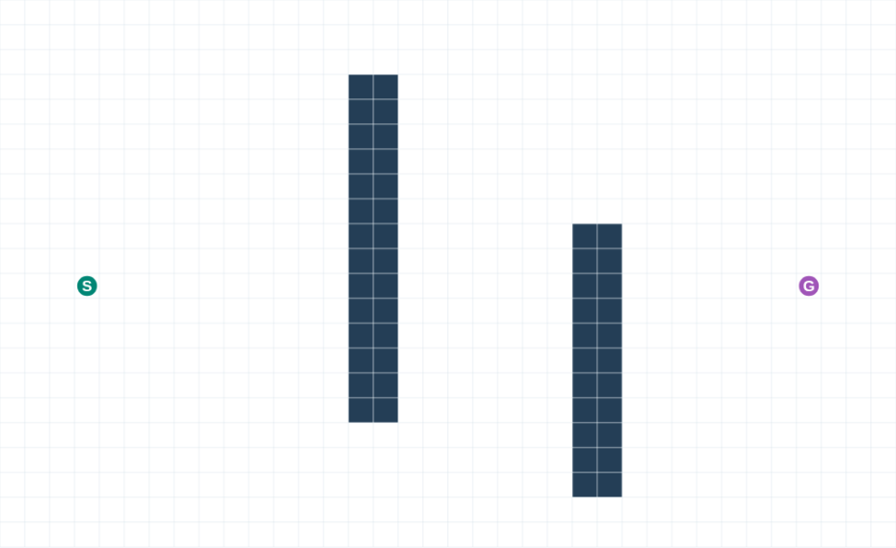
A map becomes a search graph
Nodes represent candidate robot states.
Edges represent allowed transitions.
Costs express distance, terrain, risk, or time.
Dark navy: obstacles · Green S: start · Purple G: goal
Open interactive experiment
6
Notes:
The four-neighbor grid uses unit moves and a terrain entry cost of 1 or 6. The state count and connectivity change the optimization problem. A continuous shortest path may cut between these cells, but that path is outside this graph. Start and goal markers refer to cell centers.
Visualization key: Dark navy: obstacles · Green S: start · Purple G: goal
[Sources]
https://lavalle.pl/planning/ch2.pdf
[Visuals]
Actual screenshots or animations computed by the companion synthetic Path Planning demo. Synthetic scenes and expansion counts are teaching evidence, not performance benchmarks.
[Companion demo]
Open ../Labs/PathPlanning/index.html#search relative to this presentation. Extract the offline package first.

Slide 7
BFS and Dijkstra
Method | Next state priority | Useful when
Breadth-first search | Fewest edges from start | All edges have equal cost
Dijkstra | Lowest accumulated cost g | Nonnegative unequal costs
Shared limitation | Search can spread widely | Large graphs consume memory
Compare BFS, Dijkstra and A*
7
Notes:
BFS treats every edge equally. Dijkstra uses a priority queue ordered by accumulated cost. On this demo, a weighted priority implementation with unit costs gives BFS-equivalent shortest-edge behavior. Both can explore broadly because neither uses the goal direction. Nonnegative costs are essential for Dijkstra’s settled-distance argument.
[Sources]
https://lavalle.pl/planning/ch2.pdf
[Visuals]
Editable course text, equations, or comparison table.
[Companion demo]
Open ../Labs/PathPlanning/index.html#dijkstra relative to this presentation. Extract the offline package first.

Slide 8
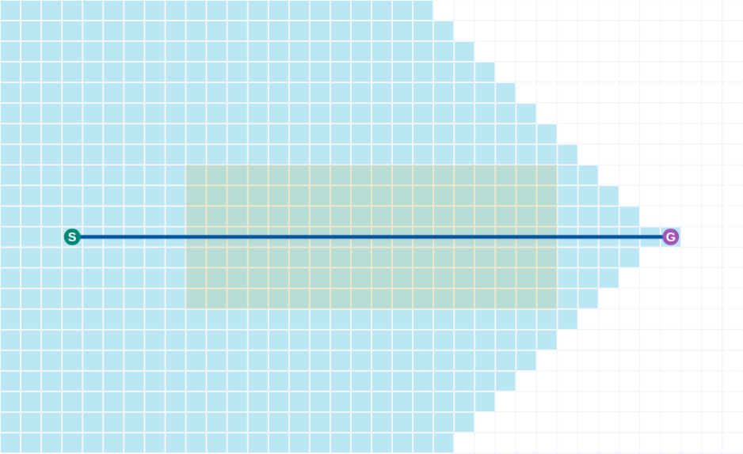
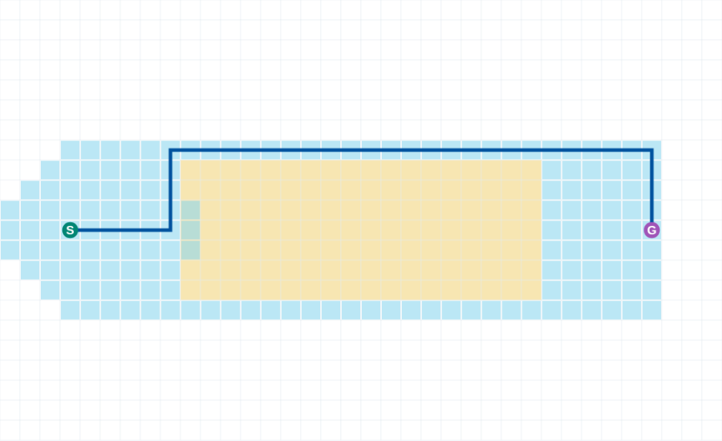
Distance and terrain cost
BFS: shortest in number of edges
A*: lower total terrain cost
BFS crosses rough ground to use fewer steps.
A* takes a longer route with lower modeled cost.
Yellow: terrain cost 6 · Cyan overlay: expanded cells · Blue: route
Open interactive experiment
8
Notes:
Both screenshots use the same start, goal and terrain. Yellow cells cost 6 on entry. The blue paths are computed results. Ask students to count steps separately from total cost. The objective function, rather than the algorithm name alone, defines what counts as a good route.
Visualization key: Yellow: terrain cost 6 · Cyan overlay: expanded cells · Blue: route
[Sources]
https://lavalle.pl/planning/ch2.pdf
[Visuals]
Actual screenshots or animations computed by the companion synthetic Path Planning demo. Synthetic scenes and expansion counts are teaching evidence, not performance benchmarks.
[Companion demo]
Open ../Labs/PathPlanning/index.html#terrain relative to this presentation. Extract the offline package first.

Slide 9
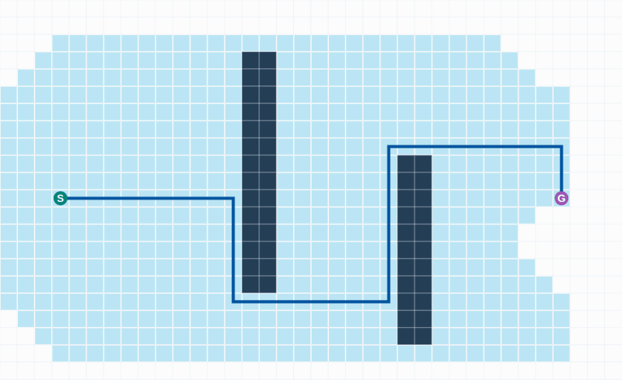
A* search
g measures the cost already spent.
h estimates the remaining cost.
A* expands the state with the lowest g + h.
Cyan: expanded cells · Blue: final route · Dark navy: obstacles
Open interactive experiment
9
Notes:
The animation shows actual expansion order on the two-wall map. The heuristic points toward the goal, while the accumulated cost prevents greedy commitment to an expensive route. A* still searches around walls because a straight-line estimate cannot predict the detour.
Visualization key: Cyan: expanded cells · Blue: final route · Dark navy: obstacles
[Sources]
https://lavalle.pl/planning/ch2.pdf
[Visuals]
Actual screenshots or animations computed by the companion synthetic Path Planning demo. Synthetic scenes and expansion counts are teaching evidence, not performance benchmarks.
[Companion demo]
Open ../Labs/PathPlanning/index.html#astar relative to this presentation. Extract the offline package first.

Slide 10
A* priority calculation
f(n) = g(n) + h(n)
A: 6 + 11 = 17 B: 9 + 8 = 17
Both candidates have a priority of 17.
Tie breaking affects expansion order, even when the optimal cost is unchanged.
10
Notes:
This is a worked arithmetic example, not a result from the rendered map. Candidate A has g=6 and h=11. Candidate B has g=9 and h=8. A consistent Manhattan heuristic with four-neighbor moves satisfies the unit-cost lower bound. Keep heuristic units compatible with edge costs.
[Sources]
https://lavalle.pl/planning/ch2.pdf
[Visuals]
Editable course text, equations, or comparison table.

Slide 11
Heuristic assumptions
Graph | Lower-bound heuristic | Condition
4-neighbor grid | Manhattan distance | Unit minimum step cost
8-neighbor grid | Octile distance | Diagonal cost √2
Euclidean motion | Straight-line distance | Cost ≥ geometric length
Changed cost model | Recheck the lower bound | Match units and transitions
11
Notes:
Admissibility means h never exceeds the true remaining optimal cost. Consistency means h(u) is at most c(u,v)+h(v). For graph search without reopening, consistency provides the standard guarantee. With admissible but inconsistent heuristics, improved states must reopen. If the minimum move cost is lower than one, rescale Manhattan distance. Manhattan can overestimate when diagonal moves are allowed. The any-angle demo on slide 43 uses Euclidean distance for its eight-neighbor A* reference, which is also admissible. Octile distance here is a valid tighter grid heuristic, not a claim about that implementation.
[Sources]
https://lavalle.pl/planning/ch2.pdf
[Visuals]
Editable course text, equations, or comparison table.

Slide 12
The A* search loop
1
Initialize the start with g = 0 and put it in OPEN.
2
Remove the lowest f state and relax its outgoing edges.
3
Update a neighbor when the new g improves its route.
4
Stop when the goal leaves OPEN, or OPEN becomes empty.
12
Notes:
Use the parent links to reconstruct a route only after the goal is selected for expansion. Discovering the goal as a neighbor is not the general optimal stopping condition. A robust implementation handles stale queue entries and reopens improved states when required.
[Sources]
https://lavalle.pl/planning/ch2.pdf
[Visuals]
Editable course text, equations, or comparison table.

Slide 13
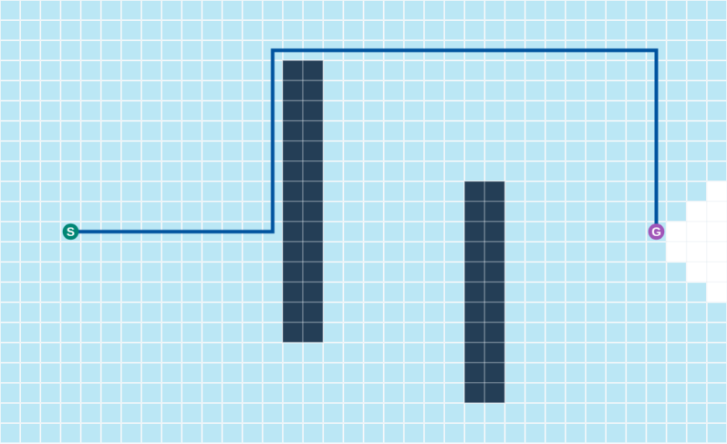
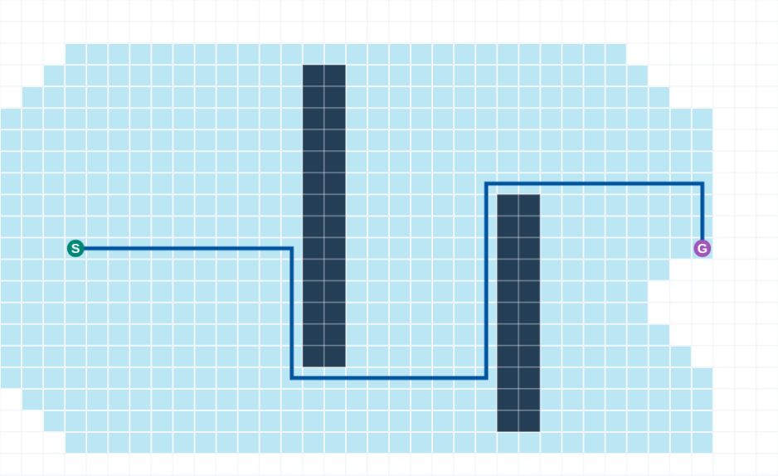
Dijkstra and A* on the same graph
Dijkstra: g priority
A*: g + h priority
Dijkstra spreads according to cost from the start.
A* also uses a lower bound on distance to the goal.
Cyan: expanded cells · Blue: minimum-cost route · Dark navy: obstacles
Open interactive experiment
13
Notes:
The screenshots show actual expanded cells on the same two-wall map. Cyan indicates processed states. Both algorithms use the same costs and return the same minimum route cost. Expansion savings depend on the heuristic and scene. Compare work counts rather than assuming a fixed speedup.
Visualization key: Cyan: expanded cells · Blue: minimum-cost route · Dark navy: obstacles
[Sources]
https://lavalle.pl/planning/ch2.pdf
[Visuals]
Actual screenshots or animations computed by the companion synthetic Path Planning demo. Synthetic scenes and expansion counts are teaching evidence, not performance benchmarks.
[Companion demo]
Open ../Labs/PathPlanning/index.html#dijkstra relative to this presentation. Extract the offline package first.

Slide 14
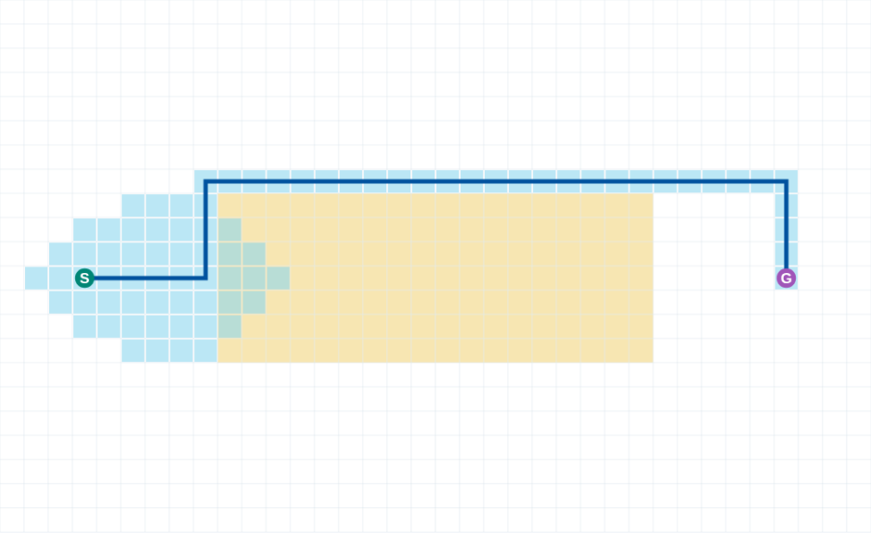
A* and Weighted A*
A* minimizes graph cost with a valid heuristic and search policy.
Weighted A*: f = g + w h, with w > 1.
The stronger heuristic can reduce expansions but lose exact optimality.
Pictured: Weighted A*, w = 2 · Cyan: expanded cells · Blue: route
Open interactive experiment
14
Notes:
The finite demo graph has positive costs and a consistent heuristic. Its shortest path does not claim continuous shortest length, feasible vehicle dynamics, or safety against future obstacle motion. Weighted A* uses f=g+w h for w>1 and can expand fewer states at the expense of exact optimality. A* failure to find a path on a graph does not prove that no physical path exists.
Visualization key: Pictured: Weighted A*, w = 2 · Cyan: expanded cells · Blue: route
[Sources]
https://lavalle.pl/planning/ch2.pdf
[Visuals]
Actual screenshots or animations computed by the companion synthetic Path Planning demo. Synthetic scenes and expansion counts are teaching evidence, not performance benchmarks.
[Companion demo]
Open ../Labs/PathPlanning/index.html#weighted relative to this presentation. Extract the offline package first.

Slide 15
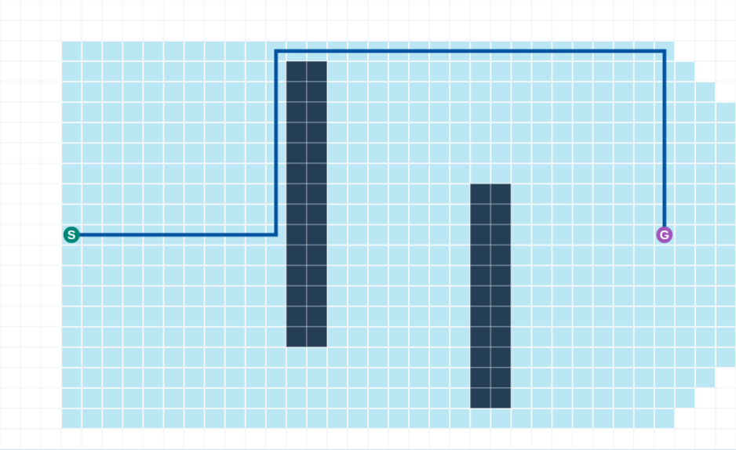
Replanning after a map change
A sensor discovers a blockage on the planned route.
Edge costs change when a cell becomes occupied or free.
Incremental search reuses earlier work.
Cyan: initial D* Lite expansions · Blue: initial route
Open interactive experiment
15
Notes:
D* originated with Stentz in 1994. Present the road-closure example: the destination remains the same while the robot advances and its knowledge changes. A robot must still detect the blockage and stop safely. Incremental graph search addresses recomputation after changes, not perception or collision prediction.
Visualization key: Cyan: initial D* Lite expansions · Blue: initial route
[Sources]
https://publications.ri.cmu.edu/the-d-algorithm-for-real-time-planning-of-optimal-traverses
[Visuals]
Actual screenshots or animations computed by the companion synthetic Path Planning demo. Synthetic scenes and expansion counts are teaching evidence, not performance benchmarks.
[Companion demo]
Open ../Labs/PathPlanning/index.html#replan relative to this presentation. Extract the offline package first.

Slide 16
D* and D* Lite
Method | Origin | Core idea
D* | Stentz, 1994 | Repair routes after cost changes
D* Lite | Koenig & Likhachev, 2002 | Reuse backward g / rhs values
Repeated A* | New search after each edit | Discard previous search state
16
Notes:
D* Lite is algorithmically distinct from D*. It builds on Lifelong Planning A* and produces a similar replanning behavior. The demo implements D* Lite, so name it accurately when explaining the code. Both belong to incremental graph search. Neither automatically reasons about the time at which a moving object will intersect the robot.
[Sources]
https://publications.ri.cmu.edu/the-d-algorithm-for-real-time-planning-of-optimal-traverses
https://idm-lab.org/bib/abstracts/papers/aaai02b.pdf
[Visuals]
Editable course text, equations, or comparison table.

Slide 17
D* Lite consistency
rhs(goal) = 0
rhs(s) = min [ c(s, s′) + g(s′) ] for s ≠ goal
g(s) = rhs(s) means locally consistent
g is the stored estimate of cost to the goal.
rhs checks that estimate against one step through a neighbor.
A changed edge makes affected states inconsistent.
17
Notes:
D* Lite initializes rhs(goal)=0, searches backward, and processes inconsistent states by a two-part priority key. The start-dependent heuristic and km adjustment allow the start to move while retaining estimates. This slide shows the local consistency relation rather than the full algorithm. The engine updates both endpoints affected by a cell/cost edit.
[Sources]
https://idm-lab.org/bib/abstracts/papers/aaai02b.pdf
[Visuals]
Editable course text, equations, or comparison table.

Slide 18
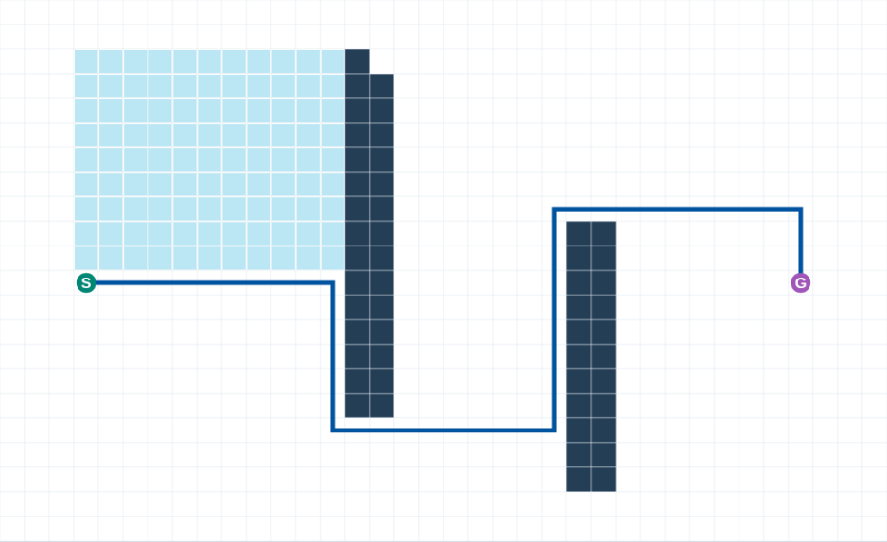
D* Lite repairs the route
The blocked cell changes the route.
Cyan shows the states processed by this repair.
The demo compares route cost and expansions with a fresh A* search.
Cyan: latest repair expansions · Blue: repaired route · Dark navy: blocked cells
Open interactive experiment
18
Notes:
The after screenshot comes from a real click on the route, followed by D* Lite repair. Earlier g and rhs arrays remain in memory. Both final costs agree with the same graph optimum. Initial search and latest repair counts are distinct, and cumulative D* work remains visible. Some map changes can make repair more expensive than a new search.
Visualization key: Cyan: latest repair expansions · Blue: repaired route · Dark navy: blocked cells
[Sources]
https://idm-lab.org/bib/abstracts/papers/aaai02b.pdf
[Visuals]
Actual screenshots or animations computed by the companion synthetic Path Planning demo. Synthetic scenes and expansion counts are teaching evidence, not performance benchmarks.
[Companion demo]
Open ../Labs/PathPlanning/index.html#replan relative to this presentation. Extract the offline package first.

Slide 19
When incremental replanning helps
Situation | Expected benefit | Remaining problem
Few changed edges | Reuse unaffected estimates | Detect changes correctly
Robot advances | Retain goal-distance values | Maintain consistent priorities
Large map revisions | Benefit can shrink | Many states need repair
Moving traffic | Update current occupancy | Predict motion and timing
19
Notes:
Small localized changes often let incremental search reuse much of its earlier computation. Changed goals, major remapping and altered state spaces can reduce that benefit or require reinitialization. Fast replanning also depends on how many sensor changes reach the costmap. Repeatedly flipping occupancy from noisy observations can create excessive work.
[Sources]
https://publications.ri.cmu.edu/the-d-algorithm-for-real-time-planning-of-optimal-traverses
https://idm-lab.org/bib/abstracts/papers/aaai02b.pdf
[Visuals]
Editable course text, equations, or comparison table.

Slide 20
Popular planning families
Family | Examples | Useful problem
Graph search | Dijkstra, A*, D* Lite | Costed map / state graph
Sampling | PRM, RRT, RRT* | Continuous configuration space
Potential fields | Attraction / repulsion | Fast reactive motion guidance
Trajectory optimization | MPC, MPPI, trajectory fitting | Motion with costs and constraints
20
Notes:
These are families, not a ranking. Graph search needs a useful discretization. Sampling methods become attractive as configuration dimension grows. Optimization can encode smoothness and dynamics, but often needs a good initial guess. Many deployed systems combine a coarse global search with local optimization.
[Sources]
https://lavalle.pl/planning/ch2.pdf
https://lavalle.pl/planning/ch5.pdf
https://docs.nav2.org/rolling/configuration_and_development/configuration_guide/controller_plugins/mppi_controller/configuring_mppic/
[Visuals]
Editable course text, equations, or comparison table.

Slide 21
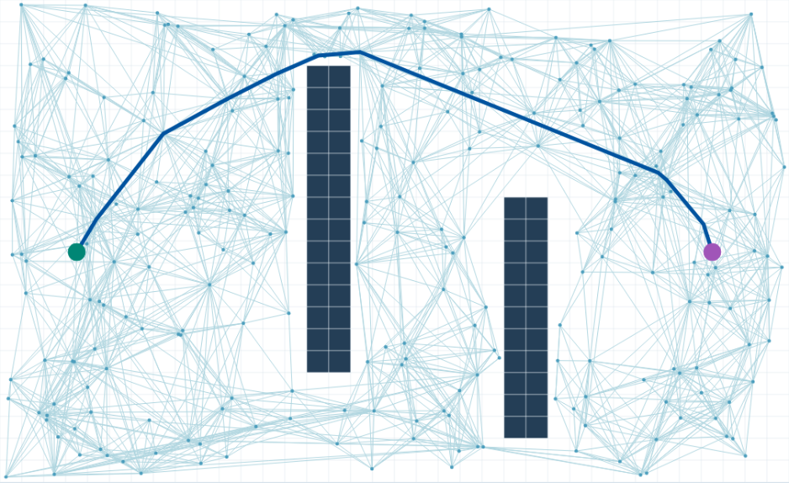
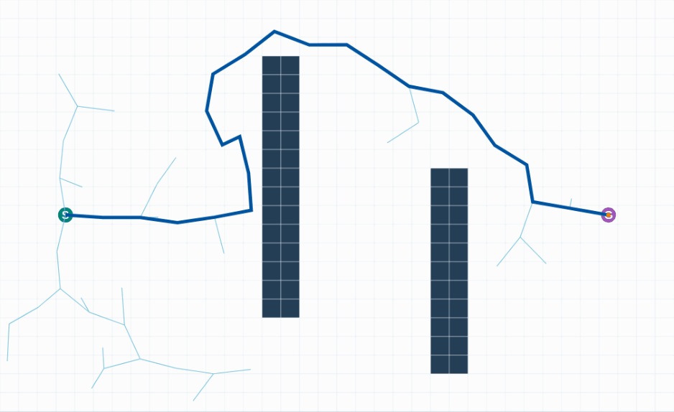
PRM and RRT
PRM: reusable roadmap
RRT: stop at the first route
PRM connects free samples for repeated queries.
RRT extends a tree toward samples from one start.
Pale cyan: connections · Blue: route · Orange: attempted RRT sample
Open PRM
Open RRT
21
Notes:
PRM samples free configurations and connects nearby samples to form a roadmap, often for repeated queries in a largely static environment. RRT incrementally extends toward random samples. The animation is the actual seeded RRT implementation in this demo. Narrow passages receive relatively few random samples. The left image is the fixed-k PRM after 300 attempts; the right animation is seeded basic RRT. Pale cyan dots and edges are retained roadmap/tree connections. Orange is the attempted RRT sample; blue is the returned route. Neither method optimizes terrain cost.
Visualization key: Pale cyan: connections · Blue: route · Orange: attempted RRT sample
[Sources]
https://lavalle.pl/planning/ch5.pdf
[Visuals]
Actual screenshots or animations computed by the companion synthetic Path Planning demo. Synthetic scenes and expansion counts are teaching evidence, not performance benchmarks.
[Companion demo]
Open ../Labs/PathPlanning/index.html#sampling relative to this presentation. Extract the offline package first.

Slide 22
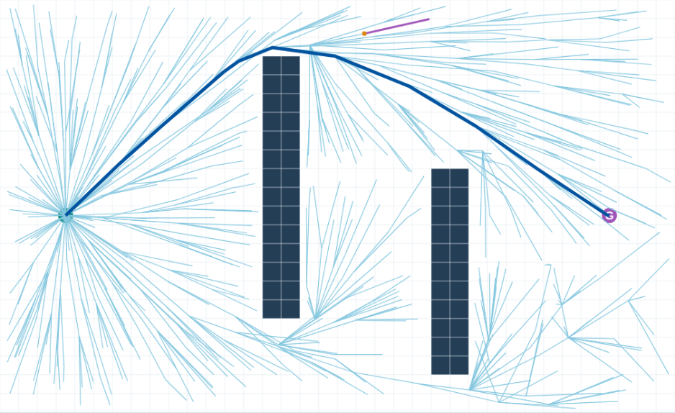
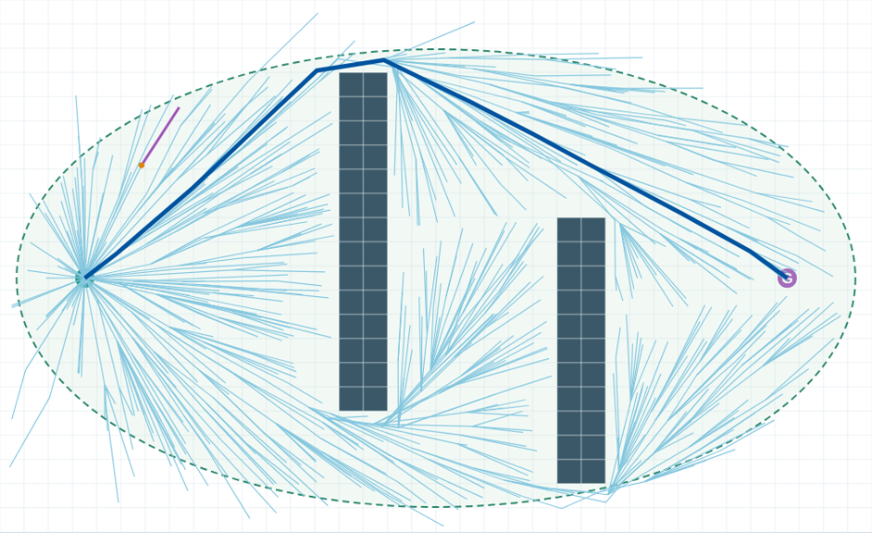
RRT* and Informed RRT*
RRT*: rewire to improve cost
Informed RRT*: focus new samples
Both keep improving after a first route.
Informed RRT* then samples the green ellipse.
Cyan: tree · Magenta: latest rewires · Blue: best route
Dashed green: improvement ellipse · Orange: attempted sample
Open RRT*
Open Informed RRT*
22
Notes:
Probabilistic completeness is an asymptotic property under assumptions, not a finite-time success guarantee. RRT* asymptotic optimality also requires its prescribed connection strategy and regularity assumptions. The demo offers basic RRT, RRT* and Informed RRT*. Basic RRT stops at its first solution; the star variants choose lower-cost parents, rewire neighbors and propagate descendant costs. All use exact segment-to-rectangle clearance for a radius-0.2 disk. Informed RRT* samples the path-length improvement ellipse only after a solution exists. The displayed finite runs do not certify optimality.
Visualization key: Cyan: tree · Magenta: latest rewires · Blue: best route; Dashed green: improvement ellipse · Orange: attempted sample
[Sources]
https://lavalle.pl/planning/ch5.pdf
https://arxiv.org/abs/1105.1186
https://arxiv.org/abs/1404.2334
[Visuals]
Actual screenshots or animations computed by the companion synthetic Path Planning demo. Synthetic scenes and expansion counts are teaching evidence, not performance benchmarks.
[Companion demo]
Open ../Labs/PathPlanning/index.html#rrtstar relative to this presentation. Extract the offline package first.

Slide 23
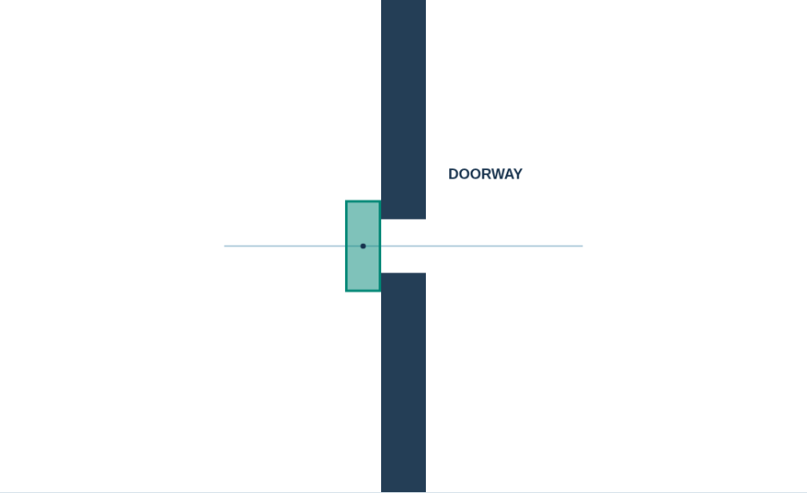
The robot occupies space
A point path ignores the physical footprint.
Configuration includes every variable needed to locate the body.
A mobile rectangle needs position and orientation.
Green rectangle: last clear pose · Pale blue: center path · Dark navy: walls
Open interactive experiment
23
Notes:
For a planar rigid body, q=(x,y,theta). An arm needs joint angles. An obstacle can block different configurations at different orientations. The pictured green rectangle is the last clear pose; the next translation is rejected, so the robot does not enter the wall. Configuration-space planning accounts for the entire robot body, including attached tools and loads. The exact geometry changes when the robot rotates.
Visualization key: Green rectangle: last clear pose · Pale blue: center path · Dark navy: walls
[Sources]
https://lavalle.pl/planning/ch4.pdf
[Visuals]
Actual screenshots or animations computed by the companion synthetic Path Planning demo. Synthetic scenes and expansion counts are teaching evidence, not performance benchmarks.
[Companion demo]
Open ../Labs/PathPlanning/index.html#footprint relative to this presentation. Extract the offline package first.

Slide 24
Obstacle expansion
C_obstacle = O ⊕ (−R)
Circular robot: expansion radius = r + margin
A circular robot of radius r expands each obstacle by r.
A safety margin adds clearance for model and pose error.
24
Notes:
For translation at fixed orientation, the configuration obstacle is O ⊕ (−R), where the negative reflects the robot footprint about the reference point. For a symmetric disk this reflection has no visible effect. An orientation-dependent footprint needs a different expansion at each theta or direct footprint checking. Inflation does not compensate for arbitrarily wrong localization.
[Sources]
https://lavalle.pl/planning/ch4.pdf
https://github.com/ros-navigation/docs.nav2.org/blob/rolling/docs/configuration_and_development/tuning_guide.md
[Visuals]
Editable course text, equations, or comparison table.

Slide 25
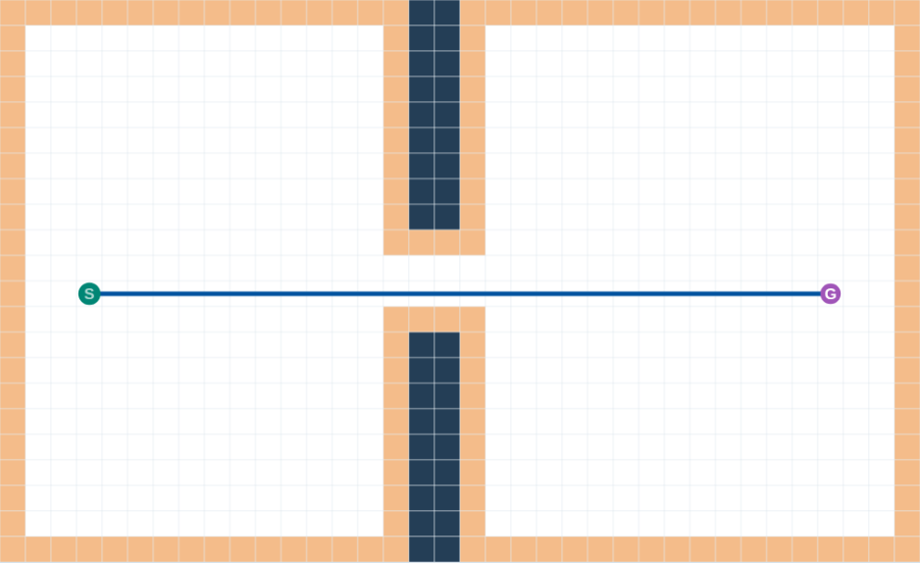
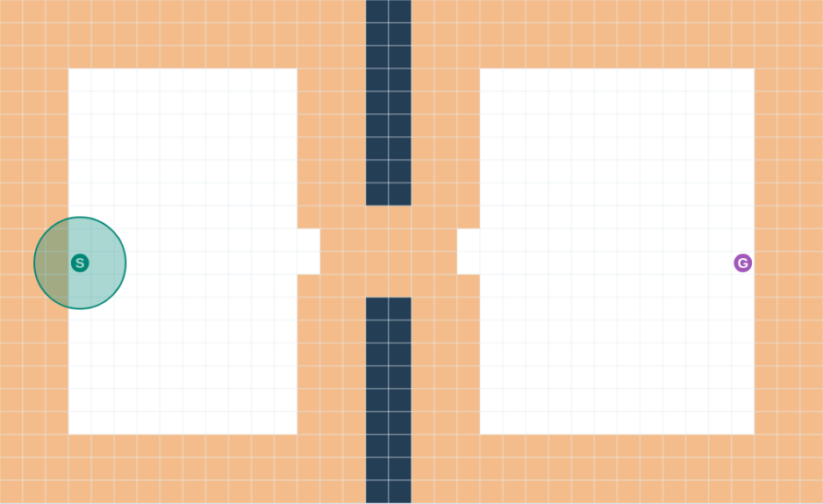
A passage closes as clearance grows
Small robot and margin
Larger robot and margin
A small footprint leaves a center route through the gap.
A larger footprint and margin remove that route.
Dark navy: obstacles · Orange: excluded cells · Blue: center route
Open interactive experiment
25
Notes:
Orange cells show conservative forbidden occupancy. The obstacle cells are unit squares, and any grid cell that intersects their Minkowski expansion is excluded. This whole-cell representation can reject a physically feasible route near a tight threshold. Using finer grid cells or checking continuous geometry can distinguish a grid artifact from actual collision.
Visualization key: Dark navy: obstacles · Orange: excluded cells · Blue: center route
[Sources]
https://lavalle.pl/planning/ch4.pdf
[Visuals]
Actual screenshots or animations computed by the companion synthetic Path Planning demo. Synthetic scenes and expansion counts are teaching evidence, not performance benchmarks.
[Companion demo]
Open ../Labs/PathPlanning/index.html#clearance relative to this presentation. Extract the offline package first.

Slide 26
Hard clearance and soft cost
Mechanism | Effect | Tuning consequence
Footprint collision | Reject overlap with obstacles | Physical feasibility
Extra safety margin | Exclude additional space | Can close narrow gaps
Graded obstacle cost | Prefer farther clearance | Trades clearance against length
Excessive repulsion | Avoid high-cost regions | Can stall in narrow corridors
26
Notes:
Hard constraints exclude collisions. A soft cost encourages wider clearance among feasible paths. Nav2 inflation includes lethal/inscribed behavior and a graded cost region, with footprint handling varying by plugin. A simple radius threshold is not a complete account of the Nav2 inflation layer. Large cost penalties can discourage progress through otherwise feasible narrow passages.
[Sources]
https://github.com/ros-navigation/docs.nav2.org/blob/rolling/docs/configuration_and_development/tuning_guide.md
https://docs.nav2.org/rolling/configuration_and_development/configuration_guide/controller_plugins/mppi_controller/configuring_mppic/
[Visuals]
Editable course text, equations, or comparison table.

Slide 27
A vehicle cannot follow every point path
q = (x, y, θ)
Turning radius ≈ L / tan(δ)
Steering constrains curvature.
Speed and braking limit what can happen next.
27
Notes:
Use the bicycle-model turning-radius relation, with wheelbase L and steering delta. A 90-degree grid corner has a direction discontinuity. Smoothing might still violate obstacles or turning radius. A differential-drive robot and an Ackermann vehicle have different allowed transitions. Reverse maneuvers also change the search.
[Sources]
https://lavalle.pl/planning/ch13.pdf
[Visuals]
Editable course text, equations, or comparison table.

Slide 28
Hybrid A* and state lattices
Method | State / transitions | Why use it
Grid A* | Position and grid steps | Simple holonomic planning
Hybrid A* | Pose with curved motions | Respect turning constraints
State lattice | Pose and motion primitives | Search executable connections
Remaining check | Full footprint and timing | Steering feasibility alone is insufficient
28
Notes:
Hybrid A* propagates continuous vehicle motions while using discretized search bookkeeping. State lattices connect states through predefined feasible motion primitives. Both can include reverse driving and heading. Their exact guarantees depend on discretization, primitive coverage, costs and implementation. Nav2 lists Smac Hybrid-A* and lattice planners for relevant robot kinematics.
[Sources]
https://docs.nav2.org/rolling/configuration_and_development/navigation_plugins/
https://lavalle.pl/planning/ch13.pdf
[Visuals]
Editable course text, equations, or comparison table.

Slide 29
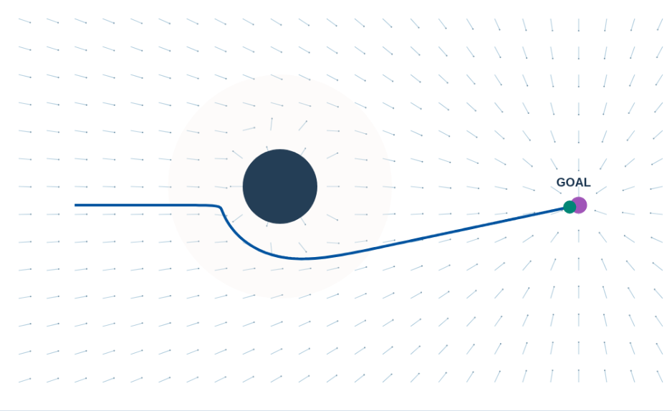
Attraction and repulsion
The goal supplies an attractive potential.
Nearby obstacles supply repulsive potentials.
The robot follows the negative gradient of their sum.
Blue-gray strokes: net force · Blue: executed trace · Green: robot
Open interactive experiment
29
Notes:
Show the open-scene screenshot. The short blue-gray strokes indicate net force direction, and the executed blue trace bends around the obstacle. The physical robot still needs a motion controller and collision checks. A potential gradient in x/y alone does not automatically satisfy car kinematics.
Visualization key: Blue-gray strokes: net force · Blue: executed trace · Green: robot
[Sources]
https://lavalle.pl/planning/ch8.pdf
[Visuals]
Actual screenshots or animations computed by the companion synthetic Path Planning demo. Synthetic scenes and expansion counts are teaching evidence, not performance benchmarks.
[Companion demo]
Open ../Labs/PathPlanning/index.html#field relative to this presentation. Extract the offline package first.

Slide 30
An artificial potential field
U_att = ½ k ||p − goal||²
U_rep = ½ η (1/d − 1/d₀)² for d < d₀
Motion direction = −∇(U_att + Σ U_rep)
Attraction grows with distance from the goal.
Repulsion grows rapidly near an obstacle.
30
Notes:
This is a common elementary potential construction. d is clearance to an obstacle, d0 is its influence range, and eta sets repulsion strength. Apply repulsion only when d<d0. The demo sums circular obstacle contributions and caps integration steps. Discuss units and gain tuning without suggesting this construction has a general global convergence guarantee.
[Sources]
https://lavalle.pl/planning/ch8.pdf
[Visuals]
Editable course text, equations, or comparison table.

Slide 31
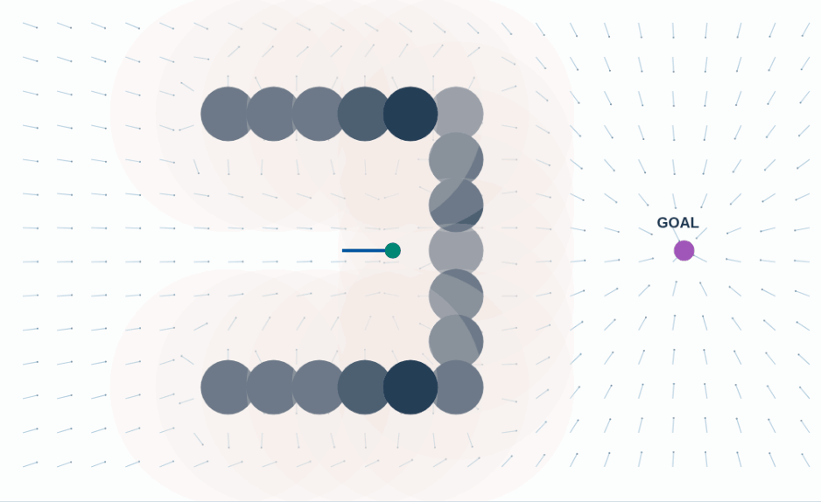
The U-shaped potential-field trap
Attraction points toward a goal beyond the wall.
Repulsion balances attraction inside the U.
The robot stops with the goal still far away.
Blue-gray strokes: net force · Blue: executed trace · Purple: goal
Open interactive experiment
31
Notes:
The animation computes the robot’s motion and net force in the U-shaped scene. The symmetric start makes the competing forces particularly clear. Here force magnitude approaches zero while distance to the goal stays large. An asymmetric perturbation may change this particular outcome but does not give the general method a completeness guarantee.
Visualization key: Blue-gray strokes: net force · Blue: executed trace · Purple: goal
[Sources]
https://lavalle.pl/planning/ch8.pdf
[Visuals]
Actual screenshots or animations computed by the companion synthetic Path Planning demo. Synthetic scenes and expansion counts are teaching evidence, not performance benchmarks.
[Companion demo]
Open ../Labs/PathPlanning/index.html#trap relative to this presentation. Extract the offline package first.

Slide 32
Responses to potential-field failure
A global route can provide waypoints around the U.
Recovery behaviors can leave a stalled configuration.
A longer-horizon search can evaluate a detour before moving.
32
Notes:
A short controller that only descends a scalar potential cannot see that temporarily moving away from the goal may enable eventual progress. Random perturbations, wall-following or changing intermediate goals can help individual scenes. Each response needs explicit safety and progress checks. Specialized navigation functions have stronger properties under restrictive construction assumptions.
[Sources]
https://lavalle.pl/planning/ch8.pdf
https://docs.nav2.org/jazzy/getting_started/navigation_concepts/navigation_servers/
[Visuals]
Editable course text, equations, or comparison table.

Slide 33
The global and local navigation loop
1
The global planner computes a route to the goal.
2
The local planner predicts candidate motions near the robot.
3
A controller executes a short part and receives a new state.
4
A blocked route or missing progress triggers replanning or recovery.
33
Notes:
The same robot repeatedly closes this loop. Routes, local trajectories and commands should use consistent frames and timestamps. A local planner can stop even while the global route remains visible, because nearby sensed geometry differs from the global map. Stopping can be a valid action, but indefinite stopping requires a progress/recovery policy.
[Sources]
https://docs.nav2.org/jazzy/getting_started/navigation_concepts/navigation_servers/
[Visuals]
Editable course text, equations, or comparison table.

Slide 34
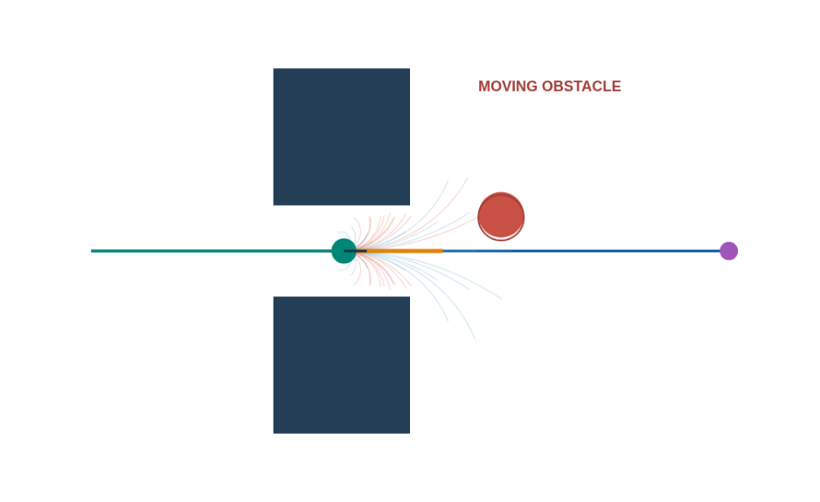
Local trajectory sampling
Each candidate uses a different forward speed and turn rate.
Sampled collision checks reject predicted overlaps.
A score balances progress, path following, and motion.
Blue: global route · Cyan / pale red: accepted / rejected predictions
Orange: chosen prediction · Green: executed motion · Solid red: obstacle now
Open interactive experiment
34
Notes:
The screenshot shows unicycle rollouts from the previous decision pose, followed by 0.1 second of execution. The robot marker and solid red obstacle are at the current time; the thin red outline is the obstacle at planning time. Orange marks the chosen candidate. Cyan/pale red mark predictions that pass/fail the configured discrete checks. The controller executes only the first 0.1 second, then samples again. It uses an ideal sinusoidal obstacle model. This is DWA-like sampling, without the acceleration-reachable dynamic window or full Nav2 implementation.
Visualization key: Blue: global route · Cyan / pale red: accepted / rejected predictions; Orange: chosen prediction · Green: executed motion · Solid red: obstacle now A thin red outline marks the obstacle at planning time. A cyan rollout passed the configured discrete checks; it is not a safety certificate.
[Sources]
https://docs.nav2.org/jazzy/getting_started/navigation_concepts/navigation_servers/
https://docs.nav2.org/rolling/configuration_and_development/configuration_guide/controller_plugins/mppi_controller/configuring_mppic/
[Visuals]
Actual screenshots or animations computed by the companion synthetic Path Planning demo. Synthetic scenes and expansion counts are teaching evidence, not performance benchmarks.
[Companion demo]
Open ../Labs/PathPlanning/index.html#local relative to this presentation. Extract the offline package first.

Slide 35
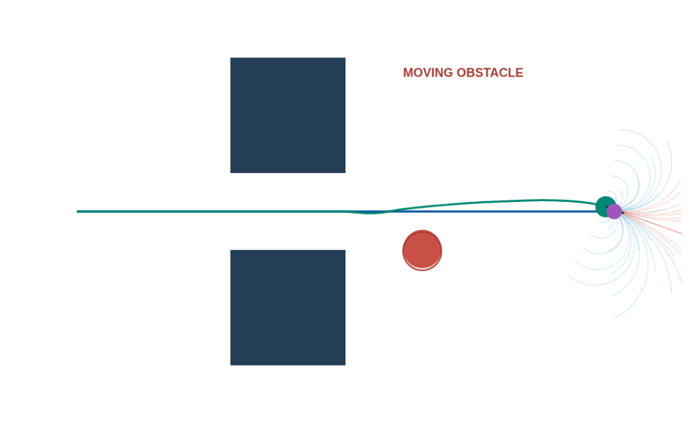
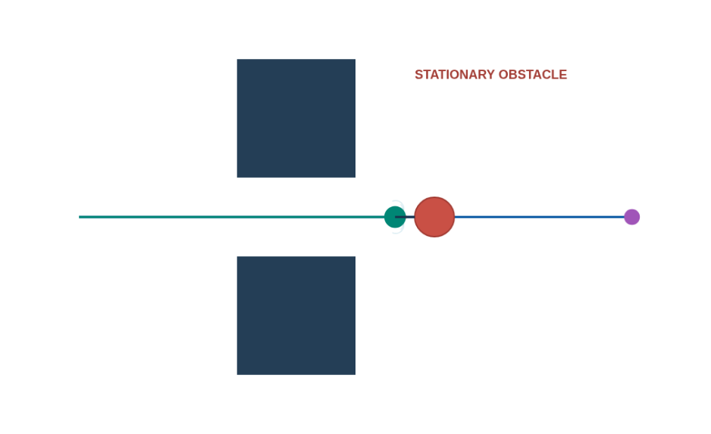
A crossing obstacle and a permanent blockage
Moving obstacle clears the route
Stationary obstacle blocks the route
A moving obstacle clears and local execution progresses.
A permanent blockage stalls the controller until the route changes.
Blue: global route · Green: executed motion · Cyan / pale red: predictions
Solid red: obstacle now · Thin red outline: obstacle at planning time
Open interactive experiment
35
Notes:
These two screenshots use the same initial route and 30 seconds of simulated control. The moving scene predicts the sinusoidal obstacle and progresses after it clears. The stationary scene stops under the demo’s discrete collision model. This is not a continuous-time or vehicle-dynamics safety guarantee. Use Update global map and replan to run A* with the current obstacle occupancy. A route built from a snapshot of a moving object can become stale, so local prediction remains necessary.
Visualization key: Blue: global route · Green: executed motion · Cyan / pale red: predictions; Solid red: obstacle now · Thin red outline: obstacle at planning time
[Sources]
https://docs.nav2.org/jazzy/getting_started/navigation_concepts/navigation_servers/
https://docs.nav2.org/rolling/configuration_and_development/configuration_guide/controller_plugins/mppi_controller/configuring_mppic/
[Visuals]
Actual screenshots or animations computed by the companion synthetic Path Planning demo. Synthetic scenes and expansion counts are teaching evidence, not performance benchmarks.
[Companion demo]
Open ../Labs/PathPlanning/index.html#local relative to this presentation. Extract the offline package first.

Slide 36
Common local planning approaches
Approach | Mechanism | Typical limitation
DWA / DWB | Score candidate velocity motions | Sampling and critic tuning
MPC | Optimize predicted controls | Model error and solve budget
MPPI | Improve sampled control sequences | Cost / noise / horizon tuning
Path following | Track a given reference | Avoidance depends on controller
Compare the MPPI-style controller (slide 44)
36
Notes:
DWA constrains sampled velocities by the robot’s dynamic reachability and braking feasibility. The demo uses only a simplified bounded sample set. MPC repeatedly solves a finite-horizon control problem. MPPI uses sampled control sequences with weighted updates to improve a sequence. A pure path follower needs its own collision handling when the scene changes. The working sequence optimizer is labeled MPPI-style; see slide 44 for its visualization and omitted importance-sampling terms. MPC, Hybrid A* and state lattices remain conceptual coverage, not implemented demos.
[Sources]
https://docs.nav2.org/jazzy/getting_started/navigation_concepts/navigation_servers/
https://docs.nav2.org/rolling/configuration_and_development/configuration_guide/controller_plugins/mppi_controller/configuring_mppic/
https://docs.nav2.org/rolling/configuration_and_development/navigation_plugins/
[Visuals]
Editable course text, equations, or comparison table.
[Companion demo]
Open ../Labs/PathPlanning/index.html#mppi relative to this presentation. Extract the offline package first.

Slide 37
Prediction horizon and stopping distance
Distance ≈ v t_reaction + v² / (2 a_brake)
Horizon distance ≈ v × prediction time
A short horizon can hide a future collision.
A longer horizon costs more computation and needs useful predictions.
37
Notes:
Reaction time includes sensing, communication and control latency. The simple distance relation assumes constant speed during reaction and constant braking deceleration afterward on a suitable surface. The demo does not model this braking envelope, so it must not claim hardware safety. The execution guard catches sampled collisions and supports teaching the distinction between planning and safety enforcement.
[Sources]
https://lavalle.pl/planning/ch13.pdf
https://docs.nav2.org/rolling/configuration_and_development/configuration_guide/controller_plugins/mppi_controller/configuring_mppic/
[Visuals]
Editable course text, equations, or comparison table.

Slide 38
Planning in different environments
Environment | Planning emphasis | Common failure
Static warehouse | Map search and footprint | Narrow aisles / loaded robot
People in a corridor | Local prediction and stopping | Wrong motion forecast
Outdoor rough terrain | Traversability and replanning | Map misses slope / traction
Road vehicle | Feasible timed maneuvers | Grid corner / crossing actor
38
Notes:
These are qualitative fit examples, not empirical rankings. Indoor geometry can be known while people move unpredictably. Outdoor terrain adds traversal costs and larger maps. A road vehicle requires kinematics, rules and actor prediction. Rapidly changing scenes can invalidate a graph path immediately after computation. Name the missing evidence before switching algorithms.
[Sources]
https://docs.nav2.org/jazzy/getting_started/navigation_concepts/navigation_servers/
https://lavalle.pl/planning/ch5.pdf
https://lavalle.pl/planning/ch13.pdf
[Visuals]
Editable course text, equations, or comparison table.

Slide 39
Greg Chirikjian’s Robot Imagination
Reconstruct an unfamiliar object for simulation.
Test candidate physical interactions and evaluate their outcomes.
Use the resulting affordance to guide a real action.
39
Notes:
The University of Delaware reference is Gregory S. Chirikjian’s Robot Imagination work, documented in his 2024 seminar. Affordance means a possible useful interaction, such as sitting on an object or using a tool. Physical simulation can test whether a candidate interaction works before execution. This extends planning from finding free-space routes to choosing useful actions with objects. Avoid asserting a current faculty appointment from the historical seminar.
[Sources]
https://ame.nd.edu/events/from-state-estimation-to-affordance-learning-and-robot-imagination/
[Visuals]
Editable course text, equations, or comparison table.

Slide 40
Imagination and motion planning
PRIMP learns distributions of demonstrated end-effector motions.
Planning uses those distributions to adapt motions around new obstacles.
RAIL combines language-based reasoning with simulated affordance tests.
40
Notes:
PRIMP represents both end-effector position and orientation in six-dimensional workspace and guides optimization-based motion planning. RAIL generates and evaluates simulated interactions to infer object functionality and functional poses. These examples show how task reasoning, geometry and motion planning connect. Neither establishes an unconditional navigation or safety guarantee.
[Sources]
https://arxiv.org/abs/2305.15761
https://arxiv.org/abs/2403.19369
[Visuals]
Editable course text, equations, or comparison table.

Slide 41
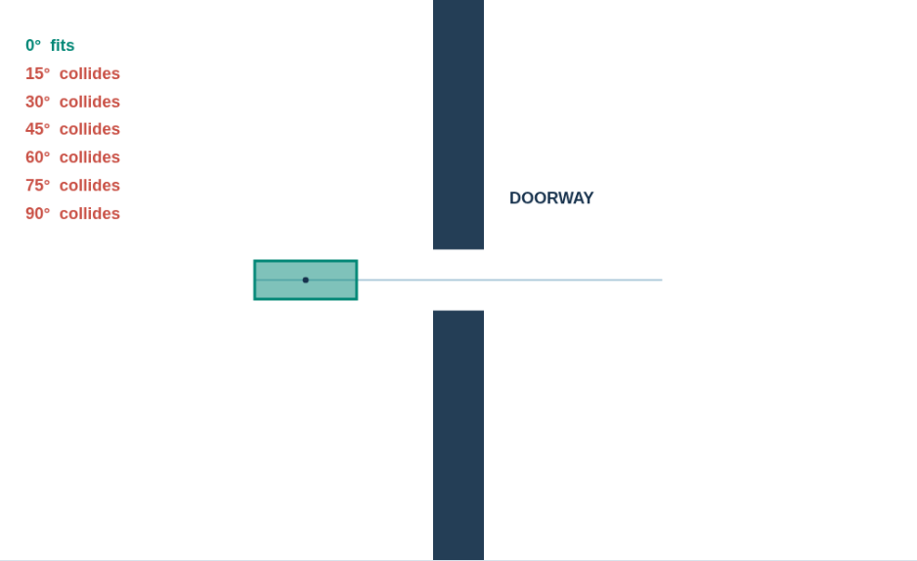
Demo: imagined doorway motions
The center follows the same straight route.
Changing orientation changes the swept robot footprint.
Candidate motions must pass collision checks before execution.
Green / red labels: candidate fits / collides · Green rectangle: clear pose
Open interactive experiment
41
Notes:
The demo tests seven fixed orientations, each with sampled translation poses through the door. It illustrates evaluating candidate actions, but omits physical contact, object affordance inference, learned motion distributions and language models. A collision-free center line alone is insufficient. Ask why a rectangle with its short side across the doorway fits while the rotated version collides.
Visualization key: Green / red labels: candidate fits / collides · Green rectangle: clear pose
[Sources]
https://lavalle.pl/planning/ch4.pdf
https://ame.nd.edu/events/from-state-estimation-to-affordance-learning-and-robot-imagination/
https://arxiv.org/abs/2305.15761
[Visuals]
Actual screenshots or animations computed by the companion synthetic Path Planning demo. Synthetic scenes and expansion counts are teaching evidence, not performance benchmarks.
[Companion demo]
Open ../Labs/PathPlanning/index.html#imagination relative to this presentation. Extract the offline package first.

Slide 42
Choosing a planning approach
Problem | Candidate approach | First check
Known cost map | A* / Dijkstra | Heuristic and graph costs
Changing map, same goal | D* Lite | Cost-change updates
Arm / complex geometry | PRM / RRT / RRT* | Configuration collision model
Vehicle maneuvers | Hybrid A* / lattice | Curvature and footprint
Moving nearby objects | Local prediction / optimization | Timing and stopping feasibility
42
Notes:
Ask students to state the model before the name of an algorithm. A known grid can support A*. Localized cost updates can justify D* Lite. Higher-dimensional configuration spaces can favor sampling. A car requires allowed steering motions. Dynamic obstacles require temporal prediction and feedback in addition to whichever global method is selected.
[Sources]
https://lavalle.pl/planning/ch2.pdf
https://idm-lab.org/bib/abstracts/papers/aaai02b.pdf
https://lavalle.pl/planning/ch5.pdf
https://lavalle.pl/planning/ch13.pdf
https://docs.nav2.org/jazzy/getting_started/navigation_concepts/navigation_servers/
[Visuals]
Editable course text, equations, or comparison table.

Slide 43
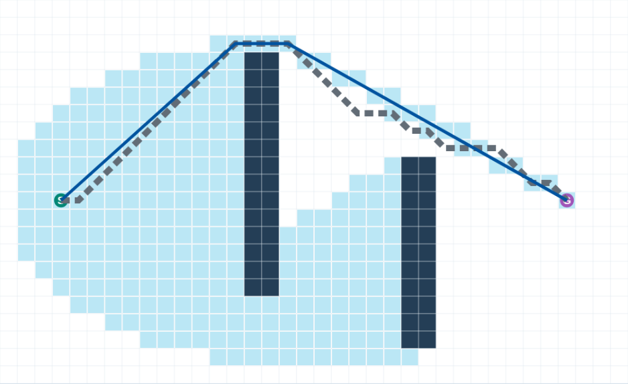
Theta* and the A* reference
Eight-neighbor A* follows grid directions.
Theta* tests direct connections through a state’s parent.
A shorter geometric route may still violate vehicle steering limits.
Dashed gray: eight-neighbor A* reference · Blue: Theta* route
Cyan: expanded cells · Dark navy: obstacles
Open interactive experiment
43
Notes:
Both routes use uniform Euclidean distance cost and a radius-0.2 circular footprint on the same cell-center map. The demo uses a Euclidean lower bound for both searches; octile distance on slide 11 is another valid grid heuristic. The thick dashed gray route is the eight-neighbor A* reference, visible beside the thinner blue Theta* route where they overlap. Cyan marks expanded states. Basic Theta* does not guarantee the globally shortest continuous route. The reference is computed before playback; the selected route appears when its search completes. Show dashed gray A* reference controls visibility.
Visualization key: Dashed gray: eight-neighbor A* reference · Blue: Theta* route; Cyan: expanded cells · Dark navy: obstacles
[Sources]
https://arxiv.org/abs/1401.3843
[Visuals]
Actual screenshots or animations computed by the companion synthetic Path Planning demo. Synthetic scenes and expansion counts are teaching evidence, not performance benchmarks.
[Companion demo]
Open ../Labs/PathPlanning/index.html#anyangle relative to this presentation. Extract the offline package first.

Slide 44
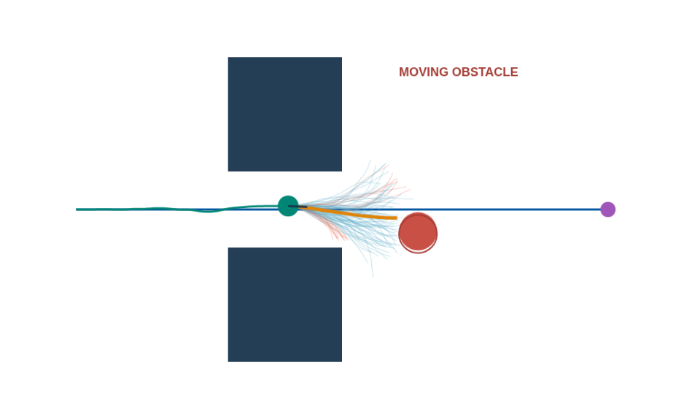
MPPI-style local sequence optimization
Perturb a sequence of speeds and turn rates.
Combine controls using exponential cost weights.
Recheck the proposal, execute 0.1 s, and repeat.
Cyan / pale red: accepted / rejected predictions · Orange: chosen prediction
Blue: global route · Green: executed motion · Solid red: obstacle now
Open interactive experiment
44
Notes:
This teaching controller uses clipped, correlated Gaussian perturbations, exponential cost weights, a shifted warm start and discrete unicycle rollouts. A weighted proposal is checked again; if invalid, a valid sampled sequence or stop candidate is considered. If no candidate passes, the display reports no valid sequence. It omits formal importance-sampling corrections, acceleration limits and production Nav2 behavior. Candidate curves start at the last decision pose, while the green robot and solid red obstacle are at the current execution time. The red outline shows the obstacle at planning time. Cyan and pale red are predictions, not executed trajectories. Compare the same scene with constant-velocity sampling on slide 34.
Visualization key: Cyan / pale red: accepted / rejected predictions · Orange: chosen prediction; Blue: global route · Green: executed motion · Solid red: obstacle now A thin red outline marks the obstacle at planning time. A cyan rollout passed the configured discrete checks; it is not a safety certificate.
[Sources]
https://arxiv.org/abs/1509.01149
https://docs.nav2.org/rolling/configuration_and_development/configuration_guide/controller_plugins/mppi_controller/configuring_mppic/
[Visuals]
Actual screenshots or animations computed by the companion synthetic Path Planning demo. Synthetic scenes and expansion counts are teaching evidence, not performance benchmarks.
[Companion demo]
Open ../Labs/PathPlanning/index.html#mppi relative to this presentation. Extract the offline package first.

Slide 45
Interactive experiments
1
Search: compare BFS, Dijkstra and A* across terrain. Record path cost and expansions.
2
Replanning: block and reopen a route cell. Compare D* Lite with fresh A*.
3
Geometry: grow the footprint, then rotate a rectangle at the doorway.
4
Local motion: change horizon and obstacle motion. Explain rejected candidates.
Open interactive experiment
45
Notes:
Use the offline package or open the companion HTML page. Students should submit a brief table of settings, observations and explanations, with one screenshot for a failure case. They should distinguish modeled infeasibility from missing representation, poor tuning and execution-model error. The README contains exact starting settings and interpretation questions.
[Sources]
https://lavalle.pl/planning/ch2.pdf
https://idm-lab.org/bib/abstracts/papers/aaai02b.pdf
https://lavalle.pl/planning/ch4.pdf
https://docs.nav2.org/jazzy/getting_started/navigation_concepts/navigation_servers/
[Visuals]
Editable course text, equations, or comparison table.
[Companion demo]
Open ../Labs/PathPlanning/index.html#search relative to this presentation. Extract the offline package first.

Slide 46
Discussion and exit questions
Why can an optimal A* path still be unsafe for a vehicle?
When might D* Lite repair cost more work than a fresh search?
Why can a local planner stop while a global route still exists?
Which assumptions would an imagination model need before real execution?
46
Notes:
Expected answers: graph optimality is relative to representation and cost; large changes can invalidate extensive prior search; local geometry, prediction and horizon can differ from the global model; and simulated geometry, contact, dynamics and uncertainty must correspond to the real situation. Use these questions to assess reasoning rather than memorized names.
[Sources]
https://lavalle.pl/planning/ch2.pdf
https://idm-lab.org/bib/abstracts/papers/aaai02b.pdf
https://docs.nav2.org/jazzy/getting_started/navigation_concepts/navigation_servers/
https://ame.nd.edu/events/from-state-estimation-to-affordance-learning-and-robot-imagination/
[Visuals]
Editable course text, equations, or comparison table.

Slide 47
Reading and resources
LaValle, Planning Algorithms: search, configuration space, sampling, feedback.
Stentz: D*. Koenig and Likhachev: D* Lite.
Nav2 documentation: planners, controllers, footprints, and cost tuning.
Chirikjian and collaborators: Robot Imagination, PRIMP, and RAIL.
Open the nine interactive experiment families
47
Notes:
References on this slide and in the speaker notes link to primary research and official documentation. Course screenshots are actual synthetic-demo computations. The demo is self-contained and requires no ROS installation. The slides remain editable, with sources and teaching explanations in their notes.
[Sources]
https://lavalle.pl/planning/ch2.pdf
https://lavalle.pl/planning/ch4.pdf
https://lavalle.pl/planning/ch5.pdf
https://lavalle.pl/planning/ch8.pdf
https://publications.ri.cmu.edu/the-d-algorithm-for-real-time-planning-of-optimal-traverses
https://idm-lab.org/bib/abstracts/papers/aaai02b.pdf
https://docs.nav2.org/jazzy/getting_started/navigation_concepts/navigation_servers/
https://arxiv.org/abs/2305.15761
https://arxiv.org/abs/2403.19369
[Visuals]
Editable course text, equations, or comparison table.

